Slide 1
Demography
© R. KYES
- The study of population structure and composition
Demography can be divided into two distinct areas of study.
1) Demographic Structure
2) Life-History Processes

Slide 2
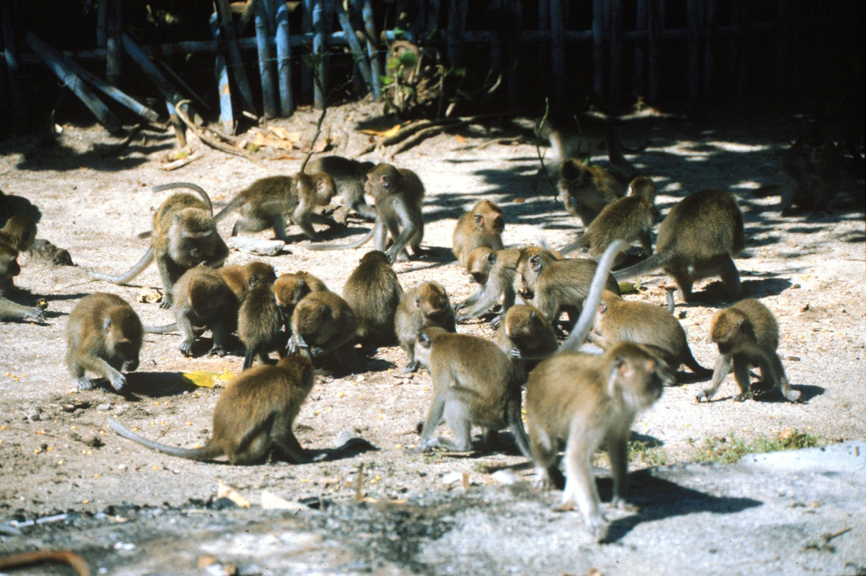
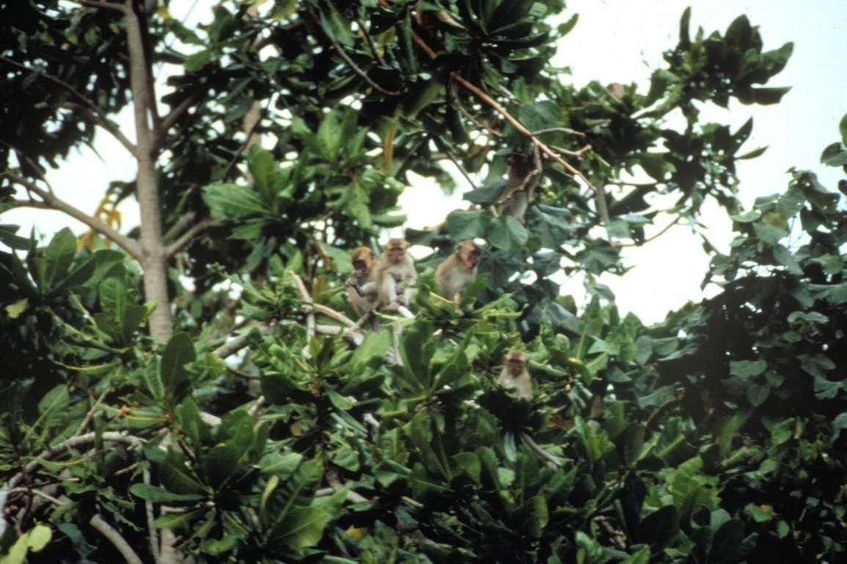
Demographic Structure
Group Size - number of animals in a group.
Group size count while crossing in trees

Slide 3
Demographic Structure
Group Size - number of animals in a group.
Group Composition - number of animal of each age/sex class.
(Infants, Juveniles, Subadults, Adults)

Slide 4
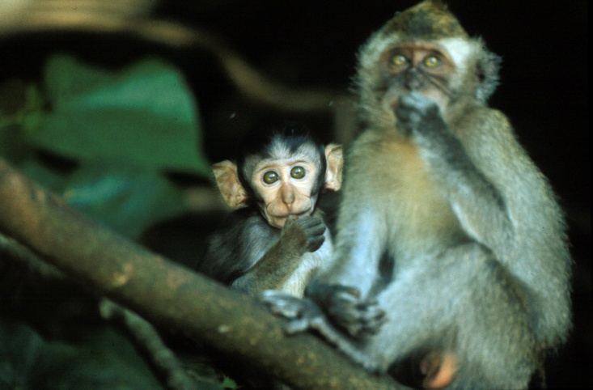
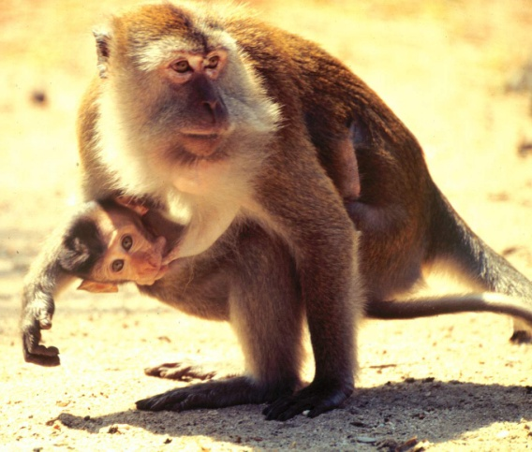
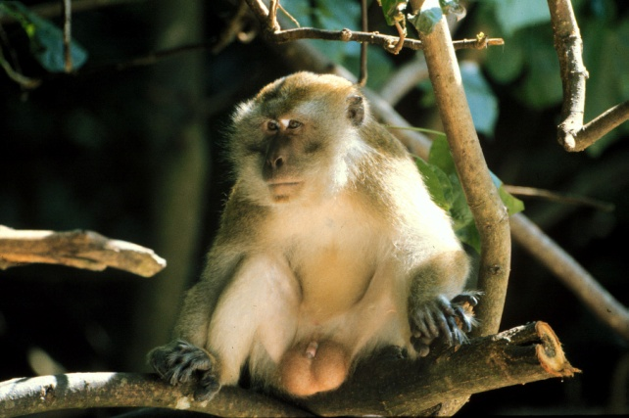
Demographic Structure
Infants: birth - 1 yrs
Juveniles: 1 - ~3.5 yrs
Subadults: ~3.5 - ~4.5 yrs
Adults: ~4.5 / 5 yrs

Slide 5
Demographic Structure
Types of Group Composition:
Solitary species (e.g., Orangutan) ???

Slide 6
Demographic Structure
Types of Group Composition:
Solitary species (e.g., Orangutan) ???
“Monogamous” Family Group (e.g., tamarins, gibbons)

Slide 7
Demographic Structure
Types of Group Composition:
Solitary species (e.g., Orangutan) ???
“Monogamous” family group (e.g., tamarins, gibbons)
One-male / multi-female grp (e.g., hanuman langur, hamadryas baboon)

Slide 8
Demographic Structure
Types of Group Composition:
Solitary species (e.g., Orangutan) ???
“Monogamous” family group (e.g., tamarins, gibbons)
One-male /multi-female grp (e.g., hanuman langur, hamadryas baboon)
Multi-male /multi female group (e.g., macaques, etc.)

Slide 9
Life-History Processes
- The factors that maintain group size and composition
Birth and Death rates
Migration (immigration [in] and emigration [out])
note: various environmental factors can also influence group size
e.g., food abundance.

Slide 10
Life-History Processes
These factors at represented in the following model:
B I D E
birth immigration death emigration

Slide 11
Life-History Processes
These factors at represented in the following model:
B I D E
birth immigration death emigration
50%:50%

Slide 12
Life-History Processes
These factors at represented in the following model:
B I D E
birth immigration death emigration
50%:50% subadult males
higher % of young males
compared to females

